Slide 1
Queue
09/10/08

Slide 2
Queue (Linear Queue)
It is a linear data structure consisting of list of items.
In queue, data elements are added at one end, called the rear and removed from another end, called the front of the list.
Two basic operations are associated with queue:
1. “Insert” operation is used to insert an element into a queue.
2. “Delete” operation is used to delete an element from a queue.
FIFO list
Example:
Queue: AAA, BBB, CCC, DDD, EEE
7
6
EEE
5
1
2
3
4
5
6
7
DDD
4
AAA
BBB
CCC
DDD
EEE
CCC
3
BBB
2
Front
Rear
AAA
1
Rear
Front
09/10/08

Slide 3
Algorithms for Insert and Delete Operations in Linear Queue
For Insert Operation
Insert-Queue(Queue, Rear, Front, N, Item)
Here, Queue is the place where to store data. Rear represents the location in which the data element is to be inserted and Front represents the location from which the data element is to be removed. Here N is the maximum size of the Queue and finally, Item is the new item to be added.
1. If Rear = N then Print: Overflow and Return. /*…Queue already filled..*/
2. Set Rear := Rear +1
3. Set Queue[Rear] := Item
4. Return.
09/10/08

Slide 4
For Delete Operation
Delete-Queue(Queue, Front, Rear, Item)
Here, Queue is the place where data are stored. Rear represents the location in which the data element is to be inserted and Front represents the location from which the data element is to be removed. Front element is assigned to Item.
1. If Front = N+1 then Print: Underflow and Return. /*…Queue Empty
2. Set Item := Queue[Front]
3. Set Front := Front + 1
4. Return.
09/10/08

Slide 5
Example: Consider the following queue (linear queue).
Rear = 4 and Front = 1 and N = 7
10
50
30
40
1
2
3
4
5
6
7
(1) Insert 20. Now Rear = 5 and Front = 1
10
50
30
40
20
1
2
3
4
5
6
7
(2) Delete Front Element. Now Rear = 5 and Front = 2
50
30
40
20
1
2
3
4
5
6
7
(3) Delete Front Element. Now Rear = 5 and Front = 3
30
40
20
1
2
3
4
5
6
7
(4) Insert 60. Now Rear = 6 and Front = 3
30
40
20
60
1
2
3
4
5
6
7
09/10/08

Slide 6
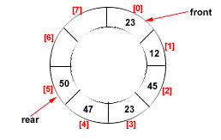
Drawback of Linear Queue
Once the queue is full, even though few elements from the front are deleted and
some occupied space is relieved, it is not possible to add anymore new elements,
as the rear has already reached the Queue’s rear most position.
Circular Queue
This queue is not linear but circular.
Its structure can be like the following figure:
In circular queue, once the Queue is full the
"First" element of the Queue becomes the
"Rear" most element, if and only if the "Front"
has moved forward. otherwise it will again be
a "Queue overflow" state.
Figure: Circular Queue having
Rear = 5 and Front = 0
09/10/08

Slide 7
Algorithms for Insert and Delete Operations in Circular Queue
For Insert Operation
Insert-Circular-Q(CQueue, Rear, Front, N, Item)
Here, CQueue is a circular queue where to store data. Rear represents the location in which the data element is to be inserted and Front represents the location from which the data element is to be removed. Here N is the maximum size of CQueue and finally, Item is the new item to be added. Initailly Rear = 0 and Front = 0.
1. If Front = 0 and Rear = 0 then Set Front := 1 and go to step 4.
2. If Front =1 and Rear = N or Front = Rear + 1
then Print: “Circular Queue Overflow” and Return.
3. If Rear = N then Set Rear := 1 and go to step 5.
4. Set Rear := Rear + 1
5. Set CQueue [Rear] := Item.
6. Return
09/10/08

Slide 8
For Delete Operation
Delete-Circular-Q(CQueue, Front, Rear, Item)
Here, CQueue is the place where data are stored. Rear represents the location in which the data element is to be inserted and Front represents the location from which the data element is to be removed. Front element is assigned to Item. Initially, Front = 1.
1. If Front = 0 then
Print: “Circular Queue Underflow” and Return. /*..Delete without Insertion
2. Set Item := CQueue [Front]
3. If Front = N then Set Front = 1 and Return.
4. If Front = Rear then Set Front = 0 and Rear = 0 and Return.
5. Set Front := Front + 1
6. Return.
09/10/08

Slide 9
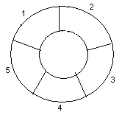
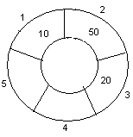
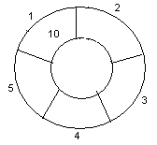
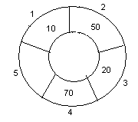
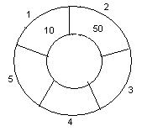
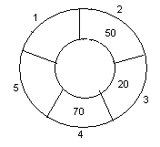
Example: Consider the following circular queue with N = 5.
1. Initially, Rear = 0, Front = 0.
4. Insert 20, Rear = 3, Front = 0.
Front
Rear
2. Insert 10, Rear = 1, Front = 1.
5. Insert 70, Rear = 4, Front = 1.
Rear
Front
Front
Rear
3. Insert 50, Rear = 2, Front = 1.
6. Delete front, Rear = 4, Front = 2.
Front
Rear
Front
Rear
09/10/08

Slide 10
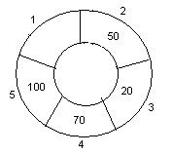
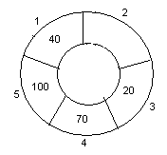
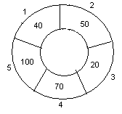
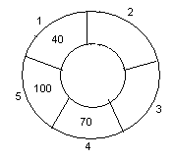
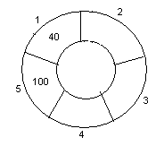
7. Insert 100, Rear = 5, Front = 2.
10. Delete front, Rear = 1, Front = 3.
Front
Rear
Front
Rear
8. Insert 40, Rear = 1, Front = 2.
11. Delete front, Rear = 1, Front = 4.
Rear
Rear
Front
Front
9. Insert 140, Rear = 1, Front = 2.
As Front = Rear + 1, so Queue overflow.
12. Delete front, Rear = 1, Front = 5.
Rear
Rear
Front
Front
09/10/08

Slide 11
END!!!
09/10/08

